Slide 1
Sports Digest LLC
Data Engineering Platforms
for Analytics – Final Presentation
December 2020

Slide 2

Contents
Executive Summary
3
Our Work Approach
7
12
Key Takeaways

Slide 3





Executive Summary > Our Team
Our team consisted of interesting individuals with diverse cultures across different continents and different time zones …
Executive Summary
Our Work Approach
Key Takeaways
Questions
United States
of America
Turkmenistan
China
Nigeria
Todd
Jiyuan
Likes Fridays
Dislikes: <Syntax Errors>
Zakir
Likes Magazines
Dislikes: Noise
Speaks 6 Languages. Programming was the hardest of them
Femi
Likes Polo and Cooking
when able to make the time

Slide 4
Executive Summary > Introduction & Objectives
A quick overview of who we are and what we set out to achieve …
Executive Summary
“We are a sports analytics consulting outfit with a keen interest in the English premiership league. As ardent followers of events in the league, we collect data from different matches; games statistic, player, coaches and referee details to draw up trends and understand behavior of events in the league.”
Real-time
Our Work Approach
Data availability
Key Takeaways
Questions
Analytics
Deep insights into soccer metrics
Our mantra remains …
Made by enthusiasts, for enthusiasts!
Our goal is to ensure timely availability of data and information at the fingertips for all lovers of the game of soccer

Slide 5
Executive Summary > Business Case
It was important for us to develop a good understanding of the requirements and business case for a clear project vision …
Executive Summary
Our Work Approach
Key Takeaways
Our Customers?
Premier League fans and fellow enthusiasts
Questions
Questions
What’s in it for our customers?
Democratize access to premiership league knowledge base
Answers
Provide analytics insights to the broader community of fans!
Why are *WE* doing this?

Slide 6

Executive Summary > Design Considerations
We understand that a good design would be essential towards delivering a useful product …
Executive Summary
Data is loaded from transformed .csv files into schema tables, bearing in mind primary and foreign key relationships between tables.
Indexes are created for fast data retrieval for relevant primary key columns.
Our Work Approach
Data Format
Constraints
Key Takeaways
Data Considerations
Normalized schema has been put in place. All data files exist in several .csv files. Data from .csv files are extracted and transformed to reflect table schema mappings.
Database DDL and DML are extracted and backed up to avoid any losses/eventualities.
Questions
Normalization
Data Structure
Scheduled backup configuration has been set up to ensure data availability. Remote stand-by database considered for remote database redundancy.
Google Cloud infrastructure will be leveraged to set up applications, compute, networking, and storage resources. MySQL relational database has been selected. MySQL clustering is being considered to avoid single instance failure.
Availability
Infrastructure
Platform Considerations
Encrypt critical data. Database roles will be implemented to restrict access to relevant data. Data privacy principles will be applied as part of data governance.
Visualizations on Tableau will be in the form of dashboards. Data filters will be included for drill-down analysis.
Security
User Experience

Slide 7





Our Work Approach > Overall Approach
We developed a phased approach to enable the realization of our project objectives by leveraging our experiences, tools and insights …
Executive Summary
Our Work Approach
1.
Team Setup
2.
Research & Data Collection
3.
Modeling
& ETL
4.
Query & Visualization
5.
Final
Project Presentation
Overall Approach
Phases
Key Activities
Key Takeaways
Questions
Team members volunteered to be a part of the team
Defined objectives
Meeting schedules
Primarily collect data
Match Statistics - 1
Matches played, result, championships etc. for the past years
Team Statistics - 2
Teams on premier league every season, players, coaches etc.
Player Statistics - 3
Names, ages, number of goals, cards, penalties etc.
Championships- 4
Teams attended, results, scores etc.
Designed EER model
Setup DDLs
Collected data files
Data extraction
Data Transformation
Data Loading
Developed submission queries
Developed visualizations
Present project presentation
Take questions and feedback
Activities
Tools
Start
3 Weeks
5 Weeks
2 Weeks
Where we are !
End
https://sports-statistics.com/sports-data/soccer-datasets/
https://footystats.org/download-stats-csv
https://footystats.org/download-stats-csv
https://en.wikipedia.org/wiki/List_of_English_football_champions

Slide 8
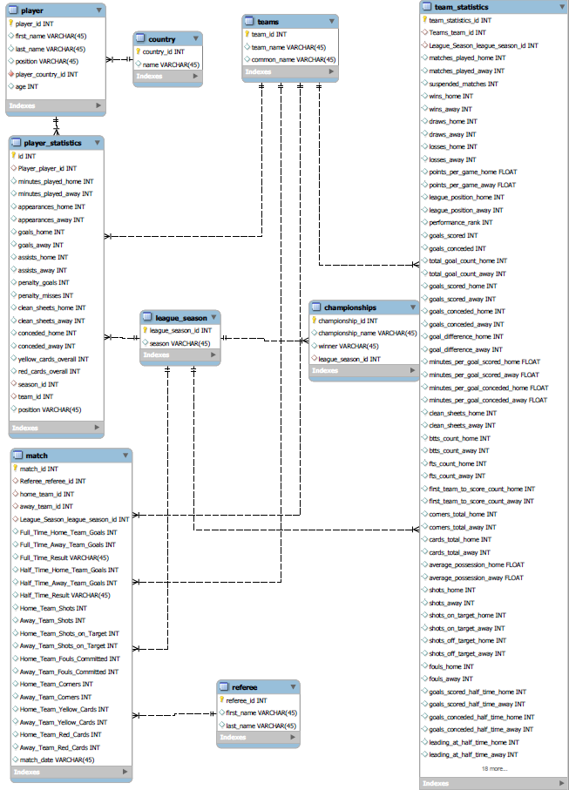
Our Work Approach > Key Activities
Enterprise Entity Relational Model was developed after a clear understanding of our legacy data structure and format…
Executive Summary
Our Work Approach
Entities
Player
Player Statistics
Match
Country
League Season
Referee
Teams
Team Statistics
Championships
Overall Approach
Key Activities
Key Takeaways
Questions

Slide 9



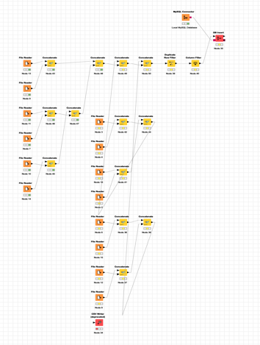
Our Work Approach > Key Activities
Our Data Extraction Transformation and Loading process was enabled using KNIME as our primary tool which connect both source and target data sources …
Executive Summary
Our Work Approach
Overall Approach
2. Transformation
4. Migration ETL
Key Activities
Staging Area & Quality Metrics DB
1. Extract
3. Load
5. Load
Key Takeaways
Questions
Legacy
Data Source
Data Services
Data Services
Destination
Data Source

Slide 10
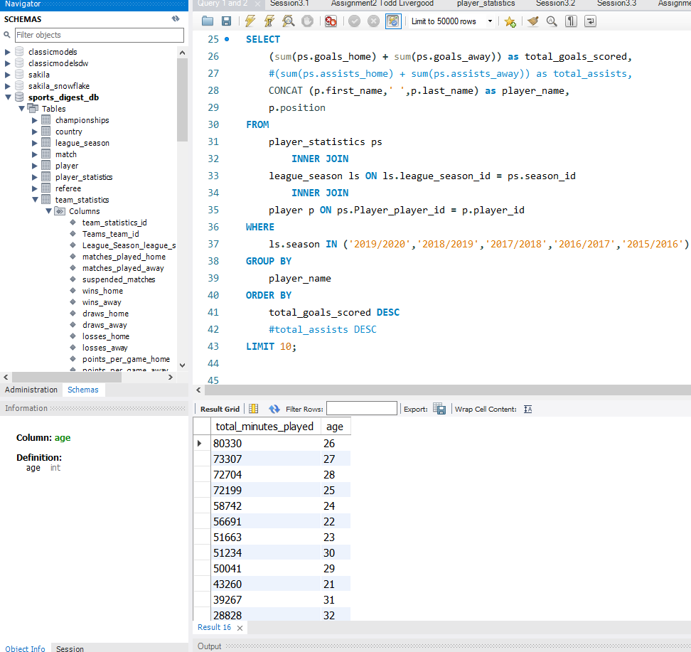
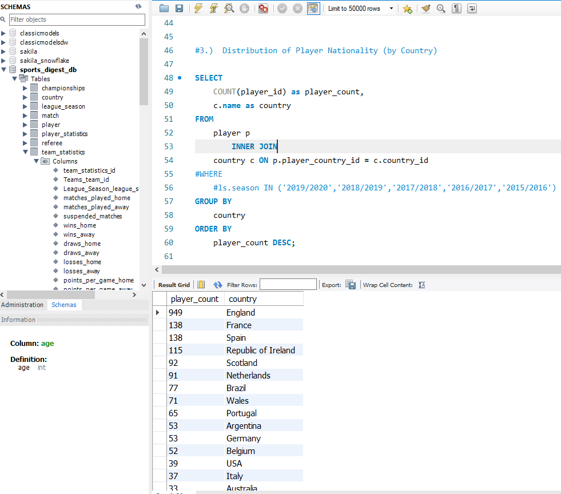
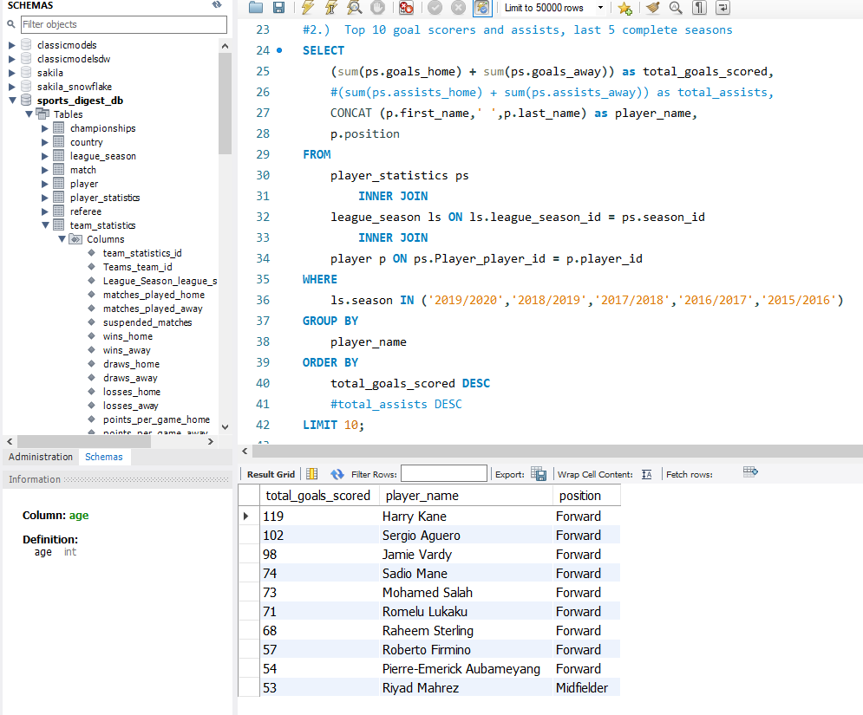
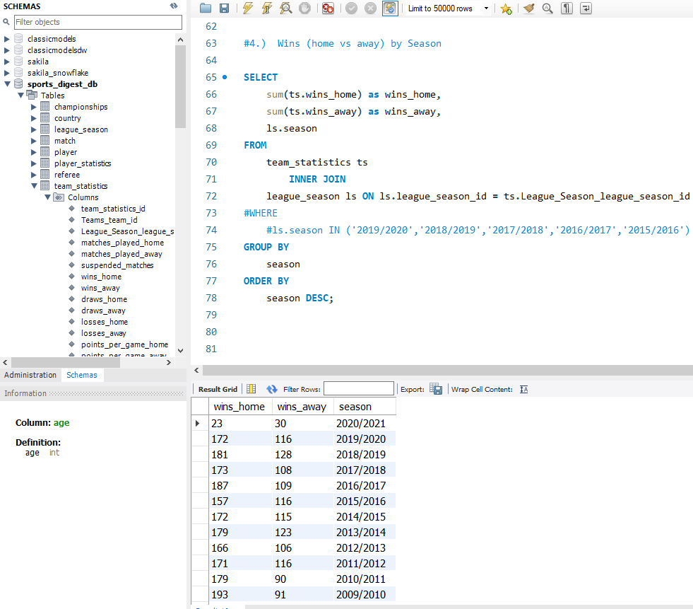
Our Work Approach > Key Activities
SQL Queries allowed us verify the quality the transformed data loaded into our database – Screenshots & quick demo
Executive Summary
1: Playing time by player age
3: SQL Queries – Screenshots & quick demo
Our Work Approach
Overall Approach
Key Activities
Key Takeaways
Questions
2: Top 10 goal scorers and assists, last 5 seasons
4: Wins (Home vs Away) by season

Slide 11
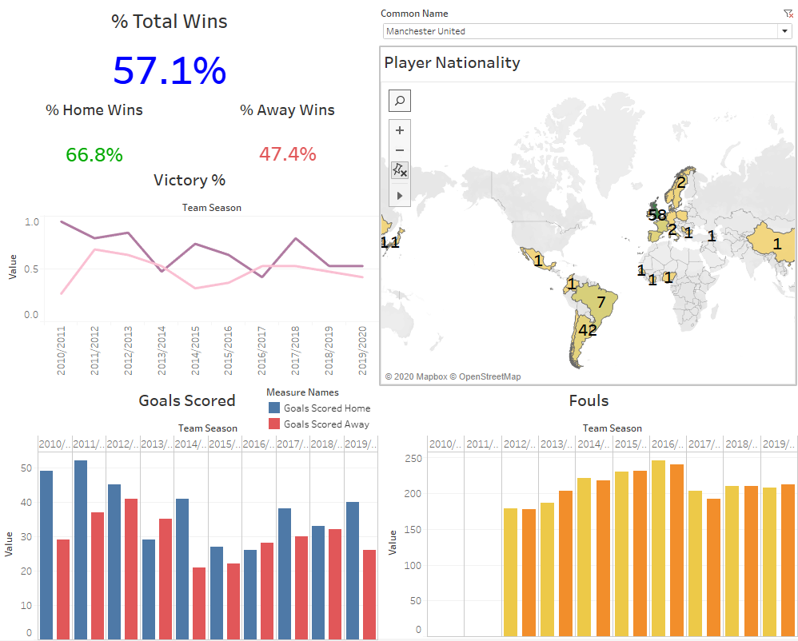
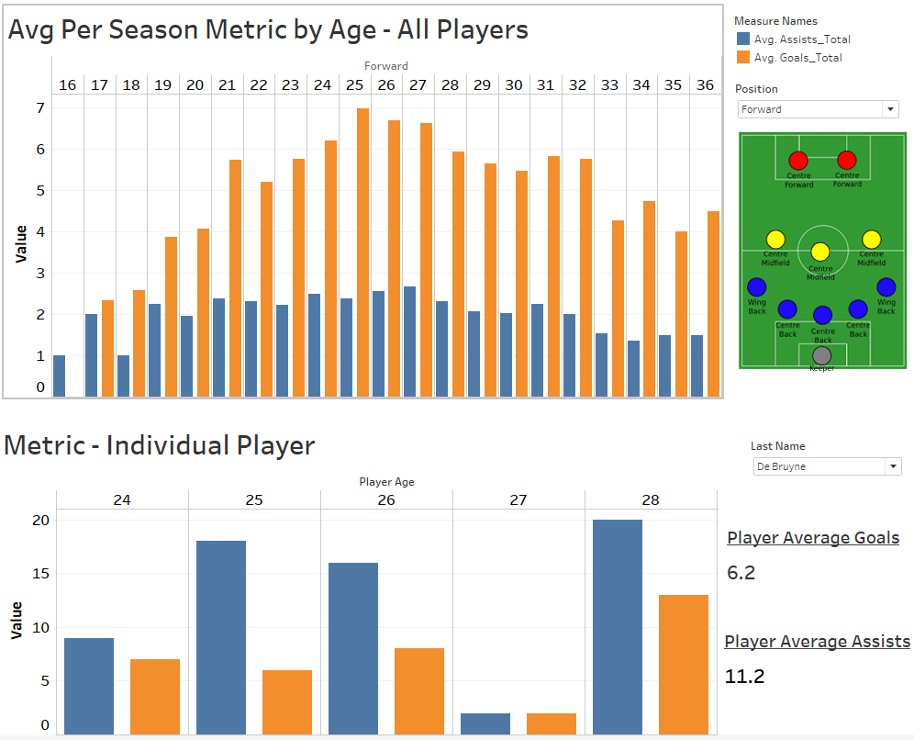
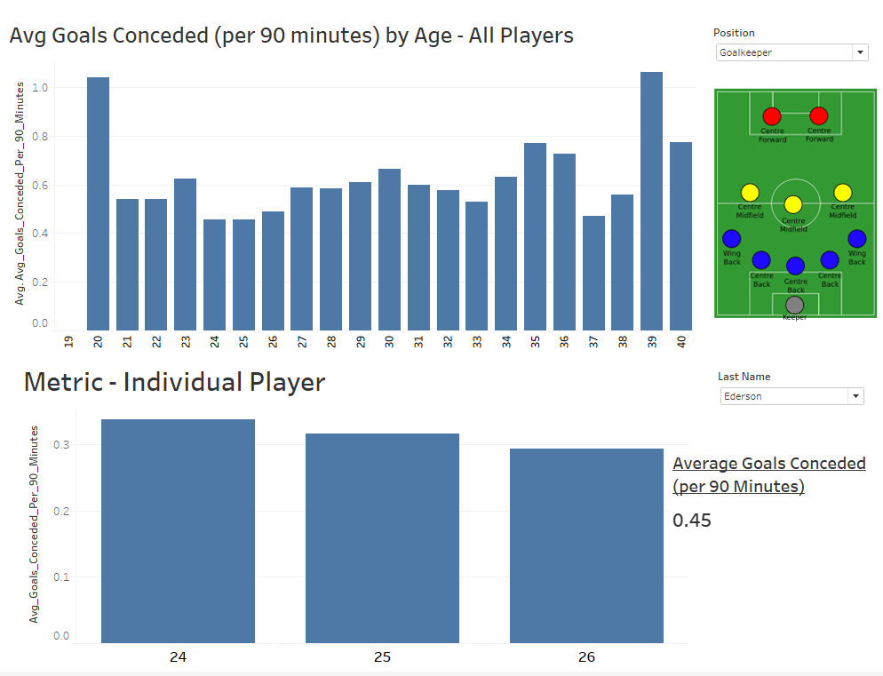
Our Work Approach > Key Activities
Tableau was essential in displaying insights for our data – Screenshots & quick demo
Executive Summary
Our Work Approach
Overall Approach
Key Activities
Key Takeaways
Questions

Slide 12
Key Takeaways> Challenges, Learnings and Potential Improvements
Adopting standardized processes aligned with business objectives across the organization will deliver significant benefits...
Executive Summary
Our Work Approach
Challenges
Difficulty in sourcing complete cohesive data hence we had to scrape data from different sources
Unreadable data format as a result of corrupt data conversion (i.e., in player names)
Difference in time zone
Internet connectivity issues
Key Takeaways
Questions
Biggest Learnings
Advanced use of my MySQL – SQL data dump, database constraints maintenance, error interpretation
ETL Process and the KNIME tool
Tableau tips tricks – especially the use of relationships over joins
General soccer domain knowledge
Potential Improvements
Inclusion of key data variables e.g., Salary, Injury details etc.
Refined/polished Tableau dashboard

Slide 13
Executive Summary
Our Work Approach
Key Takeaways
Questions
Questions

